Slide 1
Epidermis &
Basement Membrane Zone
Basic Science Review
Michael Wangia, MD

Slide 2
Overview
Epidermis “Essentials”
Types of cell connections
Basement Membrane Zone (BMZ)
Laboratory tests for BMZ disorders
Clinical review of genetic disorders involving BMZ
Mini-Review

Slide 3
Epidermis Development
Cell origins:
  Keratinocytes = Ectoderm
    Native cells
  Langerhans cells = Mesoderm
    Migrate around 6 weeks or ≈ 40 days
  Melanocytes = Neural crest cells
    Migrate dorso-laterally at around 7 weeks or ≈ 50 days
  Merkel cells = Neural crest cells
    Migrate 8-12 weeks (palmoplantar areas 1st)

Slide 4
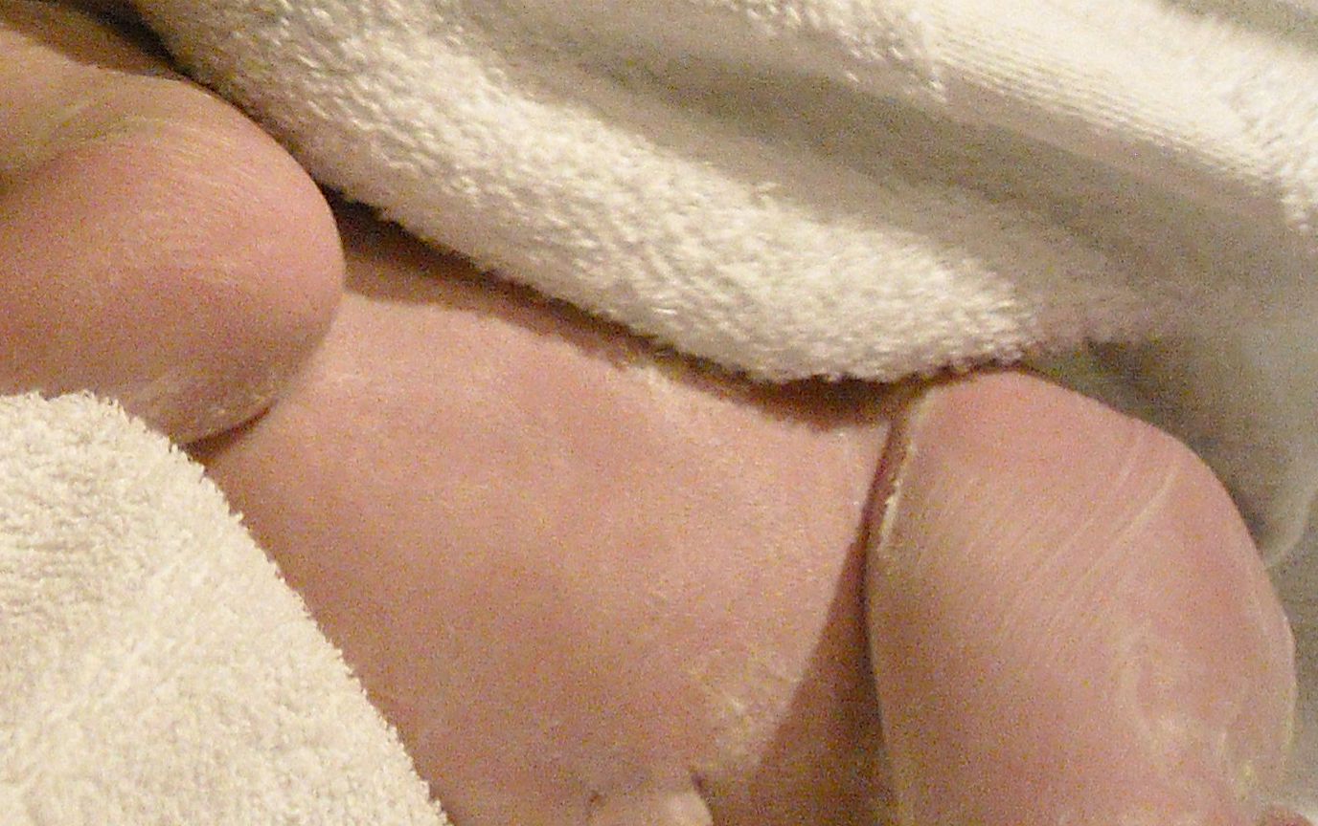
Epidermis Development (cont.)
Periderm:
  Unique epithelium during fetal development from simple basal layer
    May help metabolic exchange (microvilli) with amniotic fluid
  Begins to slough off as the epidermis differentiates
    Along with lanuga hair and sebum, becomes part of a waxy, cheese-like, white substance covering a newborn at birth (vernix caseosa)

Slide 5
Embryogenesis Basic Timeline
By 4th Week = Single cell layer of epithelium seen
5th week = Epithelium differentiates into two layers (Periderm & germinal/basal layer)
6th Week = Langerhans cells migrate to epidermis
7th Week = Melanocytes migrate to epidermis (Week 14, melanosomes seen)
8th Week = Nails develop (hyponychium keratinize 1st around Week 11)
9th- 11th Week = Hair follicles develop
14th Week = Sebaceous & Eccrine glands develop
22-24th Week = Epidermis keratinize (starting on head & palm/soles)
24th Week = Apocrine glands develop
Around 32nd Week = Similar to adult skin
3 Weeks Post-partum = Barrier function completely developed
…….thus, during this time……

Slide 6

Compared with adult skin, neonatal skin has:
1. Increased percutaneous absorption
2. Increased transepidermal water loss
3. Delayed sweating response
If perform a biopsy,
remember to clean area off afterwards!
As a result, neonatal skin is more sensitive to topical medications:
Topical medication | Potential Risk
Lidocaine | Toxic
Iodine / Betadine | Hypothyroidism
Isopropyl Alcohol | Cutaneous hemorrhagic necrosis
Prilocaine | Methemoglobinemia
Neomycin | Neural deafness
Silver sulfadiazine | Kernicterus, argyria

Slide 7
A Little on Important
Skin “Parts”
Melanocytes
Langerhans cells
Extracellular matrix
Major Glands of the Skin
Keratinocytes

Slide 8
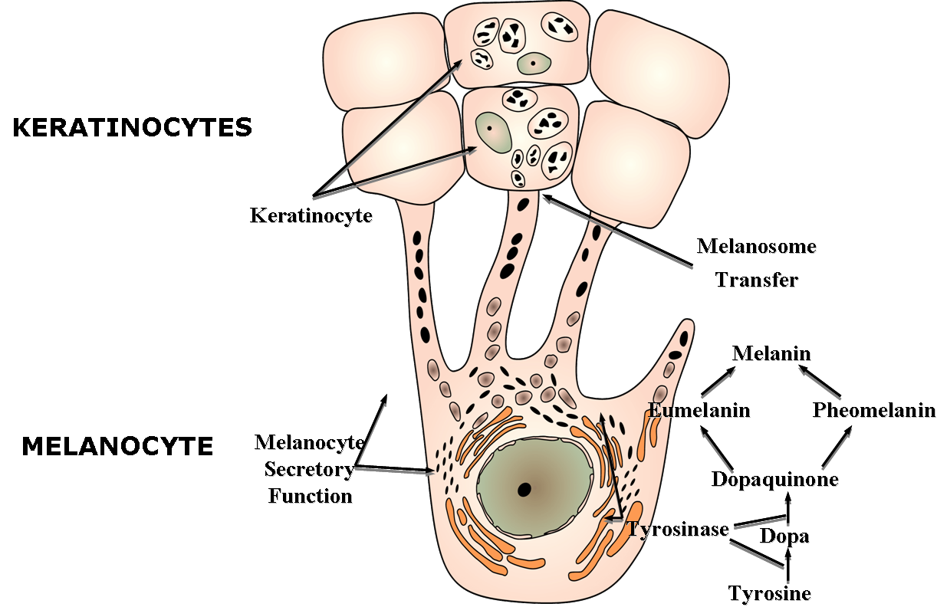
Melanocytes
Melanocytes
  1:36 ratio to “connected” keratinocytes (3-dimensionally)
  1:10 ratio to basal keratinocytes
  E-cadherin utilized for cellular adhesion (unlike keratinocyte’s desmosomes)
Image from www.therametics.com

Slide 9
Melanocytes (cont.)
Form melanosomes which contain melanin:
  Rate limiting step = Tyrosinase
  Two major types:
    Pheomelanin: red/yellow pigment; spherical melanosomes
    Eumelanin: brown/black pigment; ellipsoidal melanosomes
  Skin types NOT due to # of melanocytes, but melanin synthesis activity & size and distribution of melanosomes
Image from www.therametics.com

Slide 10
Melanin & Pigmentation
Primary function = Protect skin from UV-induced DNA damage
Melanin is regulated by the melanocortin-1 receptor (MC1R) on melanocytes
  MC1R is controlled primarily by:
    α-melanocyte stimulating hormone (α-MSH) & adrenocorticotrophic hormone (ACTH) = Increase pigmentation
    Agouti signal hormone = Decrease pigmentation
  Mutation in MC1R gene causes red-colored hair (low eumelanin)
Image from www.therametics.com

Slide 11
Drugs that Decrease Pigmentation
Inhibit or downregulate tryosinase:
  Retinoids
    Suppress tyrosinase activity, decrease quantity melanosomes, inhibit melanosome transfer
  Hydroquinone
    Inhibiting DNA and RNA synthesis, suppressing the binding of copper to tyrosinase, decreasing the formation of melanosomes, increasing the degradation of melanosomes and inducing melanocyte-specific cytotoxicity
  Vitamin C
    Interaction with copper ions at tyrosinase sites
    Reduce oxidized dopaquinone (prevent melanin formation)
  Azelaic acid
    Inhibits tyrosinase & DNA synthesis in hyperactive/abnormal melanocytes
  Kojic acid
    Fungal metabolite of Acinetobacter, Aspergillus & Penicillium
    Chelates copper bound to tryosinase and decreases number of melnosomes and dendrites
Decrease melanosome transfer:
  Niacinamide (Active derivative of Niacin/Vitamin B₃)

Slide 12
Melanoma Drug Therapies
Two main pharmacological therapies today:
  Decrease the activated pathways stimulated in melanoma cells:
    BRAF inhibitor
    MEK inhibitor
  Increase the immune system to attack the melanoma cells:
    CTLA-4 antibodies
    PD-1 antibodies

Slide 13
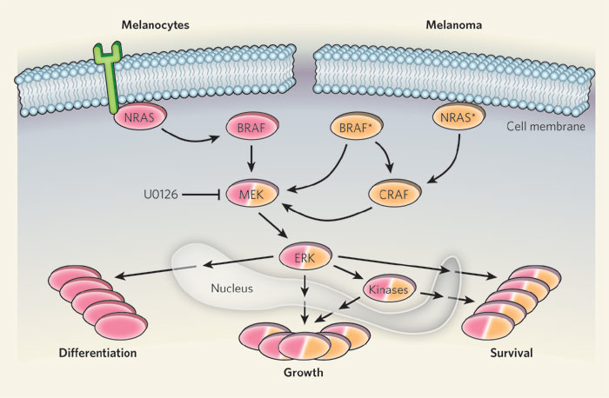
Melanocytes & Melanoma Therapy
Mitogen-activated Protein Kinase (MAPK) Pathway
Vemurafenib, Dabrafenib
Trametinib
Image from nature.com
Some newer therapies are targeting the mitogen-activated protein kinase (MAPK) pathway
About 50% Melanomas carry a BRAF mutation (proto-oncogene) with 90% at V600 position
  Vemurafenib (BRAF V600E inhibitor), FDA-approved 2011
    Side effects: SCC/KA risk, photosensitivity

Slide 14
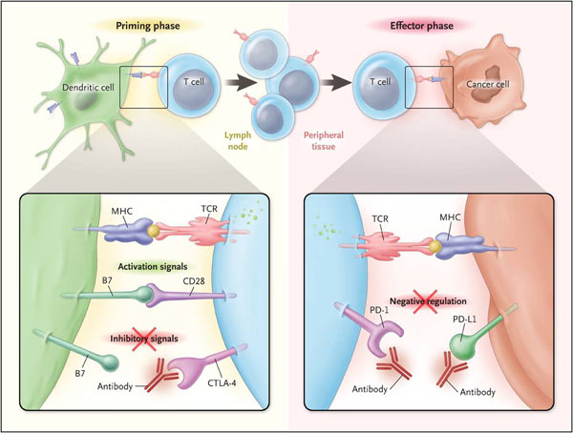
Immune System & Melanoma Therapy
CTLA-4 is transiently expressed after T-cell activation
CTLA-4 antibody
PD-1 antibody
Ipilimumab (Blocks CTLA-4 receptor, thus blocks B7 on APC)
  Keeps T-cells activated by decreasing inhibitory signal, so enhance anti-tumor immune response. Side effects: pyrexia (fever), diarrhea/colitis (“exploding colon”)
Anti-Programmed Cell Death -1 (PD-1) antibodies
  Result in negative regulation of T-cells…..so boost immune system
Image from NEJM 2012

Slide 15
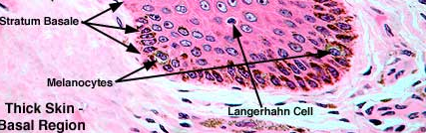
Epidermal Langerhans cells (LC)
Specialized dendritic cells (DC) that are non-phagocytic mononuclear cells
  The “Professional” antigen-presenting cells (APC) in the epidermis
    Play role in trapping/processing of antigens for T-lymphocyte presentation
  Migrate through basement membrane utilizing enzymes such as
  matrix metalloproteinases, (esp. MMP-9 & MMP-2, which are Type IV collagenases)
LC are derived from the early yolk sac & then the fetal liver (research findings in 2012)
  Maintain LC for life (unlike other DC that are replaced from bone marrow-derived cells)
  Reduced number in certain locations (palm/sole, genitalia, buccal mucosa)
  Decreased density with age and UV-exposure
  Typically found above the basal layer:
    E-cadherin utilized for cellular adhesion
Photo from faculty.une.edu/com/abell/histo

Slide 16
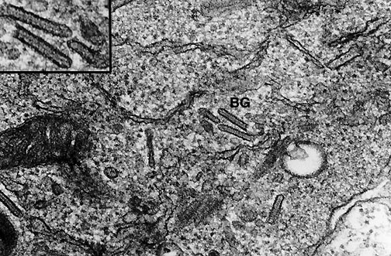
Epidermal Langerhans cells (cont.)
Unique features:
  Birbeck granules (tennis-racquet-shaped organelle) on electron microscopy
  Express antigens CD1a, S100 protein, CD45, CD101 & HLA-DR
Associated with Langerhans cell histiocytosis and play an important role in allergic contact dermatitis
Photo from www.pathologyoutlines.com

Slide 17
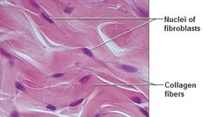
Extracellular Matrix (ECM) - Collagen
Collagen basics:
75% dry weight & 25% of volume in the dermis
In the skin, collagen produced by fibroblasts & provides tensile strength to tissue
  Made of a triple helix of 3 α-chains held together by H-bonds
    Gly-X-Y sequence (usually “X” = Proline, “Y” = Hydroxyproline)
  Final fibril assembly take place in the extracellular space
    Lysyl Oxidase (requires copper)
      Extracellular enzyme that cross-links fibrils & creates tensile strength
    Prolyl- & Lysyl-Hydroxylase (require Vitamin C & iron)
      Intracellular enzymes that stabilize collagen
  Collagen is degraded mainly by matrix metalloproteinases (MMP)

Slide 18
ECM – Collagen (cont.)
Main Collagen Types for Dermatology:
  Type I Collagen = 80% of adult collagen in dermis
    TGF-β = Upregulates Type I, III and other collagen types;
      TGF-β is induced by IL-4
  Type III Collagen = “Fetus collagen” and found in GI/vascular tissue
    Higher ratio in fetus vs. adult & 1st collagen formed in a wound
  Type IV Collagen = Lamina densa
  Type VII Collagen = Anchoring fibrils below basement membrane
Clinical correlation:
  Osteogenesis Imperfecta = Type I collagen mutation
  Ehlers-Danlos = Mutations in various collagen types
  Relapsing Polychondritis = Antibodies to Type II collagen
  Scleroderma = Pathogenesis appears to involve IL-4, TGF-β, etc.
    Best light therapy treatment = UVA1 (increases MMP-1 production by fibroblasts)
  Scurvy = Decreased collagen stability due to deficiency in proline hydroxylation from lack of co-factor Vitamin C

Slide 19
ECM – Collagen (cont.)
Collagen Stains
  Aniline blue (Mallory trichrome)
    Collagen = blue
  Movat’s pentachrome
    Collagen = yellow
  Trichrome
    Collagen = green
  Verhoeff-van Gieson & Weigert’s resorcin-fuchsin
    Collagen = red

Slide 20
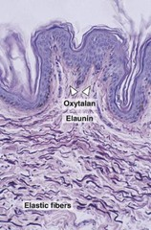
ECM - Elastin
Elastin basics:
  Responsible for resilience & elasticity
    i.e., stretch and return to original form
  Produced by fibroblasts & smooth muscle
  Main amino acids = Desmosine & Isodesmosine
  Lysyl oxidase (same as collagen):
    Requires copper co-factor
    Causes cross-linking of elastic fibers
  Elastic fibers contain elastin (90%) and microfibrils (i.e., fibrillin-1):
    Oxytalan fibers
      Mainly in superficial papillary dermis; tend to run perpendicular to epidermis
    Elaunin fibers
      Mainly in the reticular dermis; run more parallel to the epidermis (“E”)

Slide 21
ECM – Elastin (cont.)
Clinical Correlation:
  Marfan syndrome = Fibrillin-1 mutation
  Congenital contractural arachnodactyly (Beals syndrome) = Fibrillin-2 mutation
  Cutis laxa variants = Fibulin-4 and Fibulin-5
  Pseudoxanthoma elasticum (PXE) = ABCC6 mutation
    Encodes a multidrug resistance-associated protein (MRP6)
    Calcified elastic fibers on H&E
    Risk of GI hemorrhage; recommend avoid aspirin

Slide 22
ECM – Elastin (cont.)
Elastin Stains: Need to stain since not see on H&E typically:
    Verhoeff-van Gieson stain & Weigert’s resorcin-fuchsin
      Elastic tissue/fibers = black
    Orcein Giemsa
      Elastic fibers and melanin = brown-black
    Movat’s pentachrome
      Elastic fibers and nuclei = black
  NOTE: Exception PXE (calcified elastic fibers seen on H&E)

Slide 23
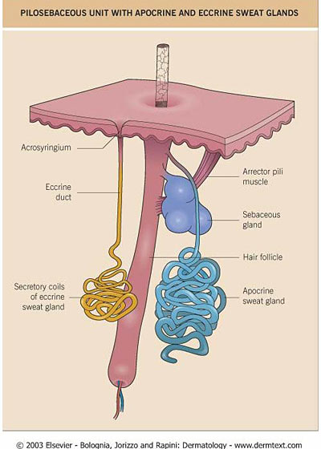
Major Glands of the Skin
Eccrine Glands
Apocrine Glands
Apoeccrine Glands
Sebaceous Glands

Slide 24
Eccrine Glands
Role in thermoregulation
Secrete via merocrine (excreted by exocytosis)
  Active at birth
Located all over body:
  Develop 1st on palm/soles (around week 14)
  Highest density are in palm & soles
Eccrine glands do not develop in some body areas, esp. in the “do-not-need-or-want-to-sweat” areas:
  External auditory canal
  Vermillion border of lips
  Clitoris, labia minora & glans of the penis
  Nail bed

Slide 25
Eccrine Glands (cont.)
Coiled gland which contains a single layer of
clear & dark cells:
  Clear cells secrete glycogen, water & electrolytes
  Dark cells secrete sialomucin
Controlled by postganglionic sympathetic fibers:
  Acetylcholine is the main neurotransmitter
  (thus, botulinum toxin works!)
Associated conditions include miliaria, syringomas, hyper-/hypohidrosis, cystic fibrosis (unable to reabsorb sodium in ducts) & hypohidrotic ectodermal dysplasia (Christ-Siemens-Touraine syndrome)

Slide 26
Apocrine Glands
Unclear function
Sterile odorless viscous secretion (sialomucin mainly)
  Secreted primarily by decapitation (“pinch off”)
  Composed of cholesterol, fatty acids, squalene, androgens, ammonia, ferric acid, etc.
    Most abundant free fatty acid causing odor in
    Caucasian men = 3-methyl-2-hexenoic acid (TMHA)
Main locations are axillae, anogential area, periumbilical area, & nipples
  Glands present at birth (develop around Week 24)
Specialized variants include:
  Moll’s gland (eyelid)
  Ear-wax glands
  Milk-producing breast glands

Slide 27
Apocrine Glands (cont.)
Androgen-dependent for development
Controlled by both:
  Sympathetic innervation (acetylcholine )
  Adrenergic stimulation (phenylephrine)
Associated conditions include:
  Fox-Fordyce disease (follicular apocrine miliaria)
  Hidradenitis suppurativa
  Bromhidrosis
    Odor due to degradation by bacteria, usually Corynebacterium spp. (rancid odor) or Micrococcus spp. (sweaty odor)
  Apocrine chromhidrosis
    Pigmented secretions due to rich lipofuscin content of apocrine sweat

Slide 28
Apoeccrine Glands
Morphologic features of both eccrine & apocrine glands
Likely role in thermoregulation
Located in only in adult axillae:
  No relationship to pilosebaceous follicle
  Develop during puberty
Controlled mainly by sympathetic innervation (acetylcholine ), but also adrenergic stimulation
Possible associated conditions include
non-folllicular apoeccrine Fox-Fordyce disease, thermoregulation/role in axillary hyperhidrosis

Slide 29
Sebaceous Glands
Role in thermoregulation:
  In hot conditions, emulsifies sweat to avoid loss
  In cold conditions, repels water from skin/hair
Secrete sebum by holocrine secretion (cells disintegrate) into infundibulum
  Sebum contain triglycerides, free fatty acids, wax esters & squalene
Associated with hair follicles, except several unique locations:
  Montgomery tubercles (areola)
  Fordyce’s spot (lips)
  Tyson’s gland (penis)
  Meibomian gland (tarsal plate of eyelids)

Slide 30
Sebaceous Glands (cont.)
Growth & sebum production controlled by androgens (esp. 5α-dihydrotestosteroine or DHT)
  Thus, increases at puberty
Associated conditions include acne, sebaceous adenoma, sebaceoma, sebaceous carcinoma

Slide 31
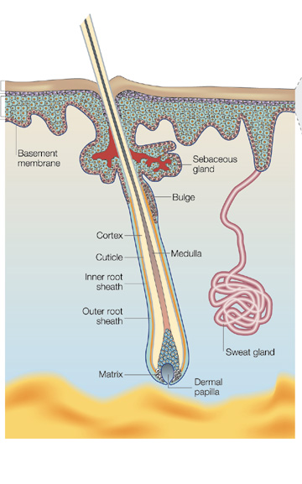
KERATINOCYTES
Two functions required of proliferating cells in a self-renewing tissue:
1. Maintain the integrity of the genome
Accomplished by Stem cells located at:
- The outer root sheath at the bulge region of the hair follicle and
- The base of rete ridges of interfollicular epidermis
Fuchs and Raghavan (2002), Nature Rev. 3: 199

Slide 32
KERATINOCYTES
Two functions required of proliferating cells in a self-renewing tissue:
Maintain the integrity of the genome
Maintain the correct cell number in the epidermis
- Accomplished by a balance between stem cells & differentiating cells, called transient amplifying cells
Fuchs and Raghavan (2002), Nature Rev. 3: 199

Slide 33
KERATINOCYTE STEM CELLS
- Stems cells are pluri-potent, slowly replicating cells
- Two options for stem cell replication:
1. Replicate symmetrically (divide into 2 equal daughter stem cells)
Stem
cell
Stem
cell
Stem
cell
Fuchs and Raghavan (2002), Nature Rev. 3: 199

Slide 34
KERATINOCYTE STEM CELLS
- Stems cells are pluripotent, slowly replicating cells
- Two options for stem cell replication:
1. Replicate symmetrically (divide into 2 equal daughter stem cells)
2. Replicate asymmetrically (stem cell divides into one equivalent stem cell and one differentiating, transient amplifying or TA cell)
Stem
cell
Stem
cell
TA
cell
Fuchs and Raghavan (2002), Nature Rev. 3: 199

Slide 35
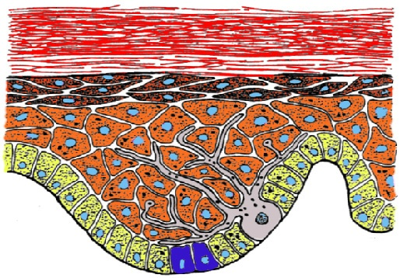
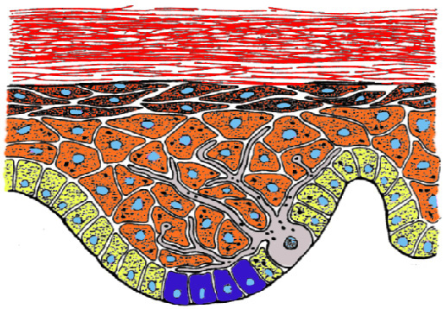
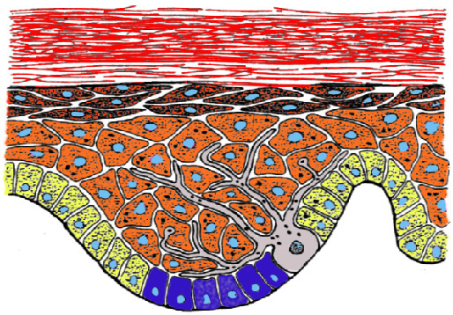
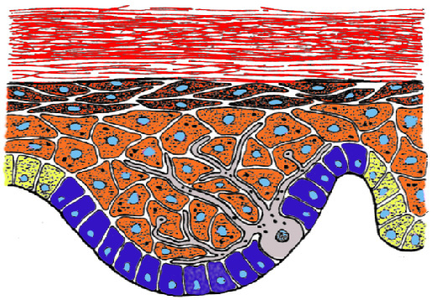
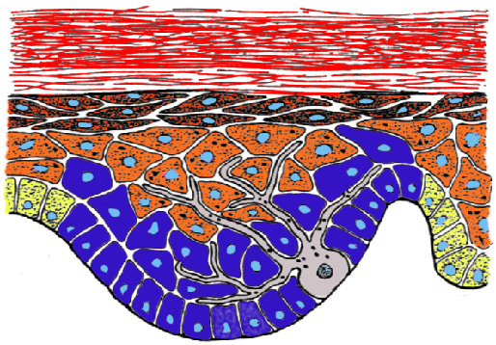
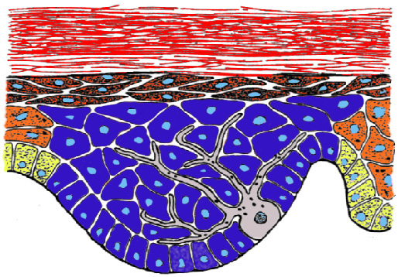
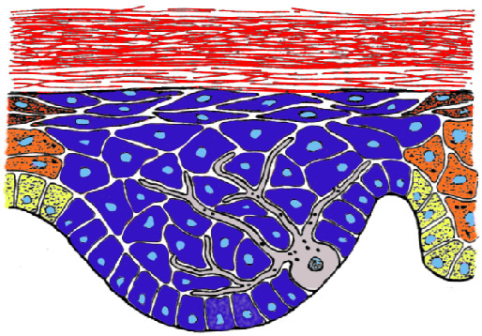
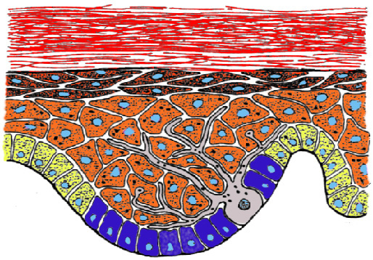
KERATINOCYTE PROLIFERATION
- most of proliferation done by transient amplifying cells (TA cells)
- in normal epidermis, all TA cells remain attached to basement membrane
- transition from stem cell to TA cell is the first step in keratinocyte differentiation
- TA cells migrate laterally along the basement membrane
- TA cells have a restricted ability to proliferate - usually divide only 3-5 times
- Once TA cells stop proliferating, they lose their attachment to the basement membrane proceed towards terminal differentiation
- most of proliferation done by transient amplifying cells (TA cells)
- in normal epidermis, all TA cells remain attached to basement membrane
- transition from stem cell to TA cell is the first step in keratinocyte differentiation
- TA cells migrate laterally along the basement membrane
- most of proliferation done by transient amplifying cells (TA cells)
- in normal epidermis, all TA cells remain attached to basement membrane
- transition from stem cell to TA cell is the first step in keratinocyte differentiation
- TA cells migrate laterally along the basement membrane
- TA cells have a restricted ability to proliferate - usually divide only 3-5 times
- most of proliferation done by transient amplifying cells (TA cells)
- most of proliferation done by transient amplifying cells (TA cells)
- in normal epidermis, all TA cells remain attached to basement membrane
- most of proliferation done by transient amplifying cells (TA cells)
- in normal epidermis, all TA cells remain attached to basement membrane
- transition from stem cell to TA cell is the first step in keratinocyte differentiation
TA
Stem

Slide 36
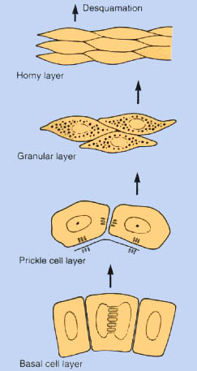
KERATINOCYTE TERMINAL DIFFERENTIATION
Keratinocyte morphology
and function
Differentiation-specific
proteins expressed
stratum corneum – keratinocytes
Contain no nucleus, thickened cell envelopes, imbedded in lipid matrix (“brick-and-mortar”)
NO new proteins expressed
stratum granulosum – cells become
elongated, usually 1-2 cell layers thick,
accumulate keratohyaline granules
keratins K1 and K10, filaggrin (keratohyaline granules), loricrin, transglutaminase 3 (assoc. DH)
stratum spinosum – cells increase in size,
increased cytoplasm:nucleus ratio, cell layer 4-6 cells thick, no further cell division
keratins K1 and K10, upper layer with
lamellar granules (loricrin, involucrin),
if wound healing, K6 & K16
stratum basale – cuboidal cells, cells within
this layer proliferate, all cells attached to the
basement membrane, one cell layer thick
keratins K5 and K14
integrins, p63
Approx.
2 Weeks to S. Corneum

Slide 37
More on Keratins
Types | Keratins | Acid vs. Basic | General size
Type I | K10-20 | Acidic | Smaller
Type II | K1-9 | Basic | Larger
Refresh your memory on keratins, primary location(s) and associated disorders before the Board Exam.
Keratin(s) | Primary Location | Disorders
2e & 10 | Palmoplantar suprabasilar keratinocytes | Icthyosis bullosa of Siemens
4 & 13 | Mucosa | White sponge nevus
5 & 14 | Basal layer | EBS
20 | Merkel cells | Merkel cell cancer

Slide 38
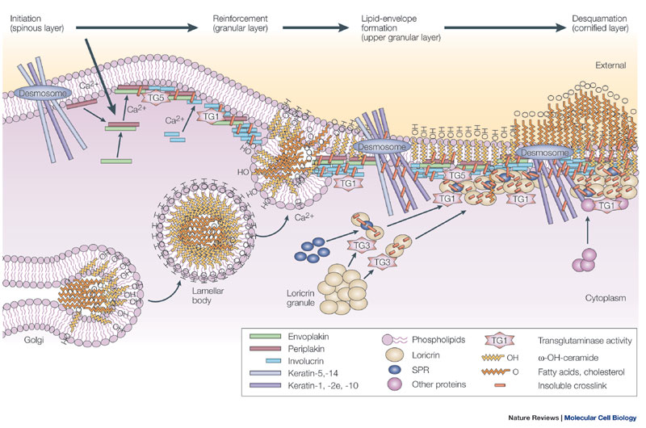
Cornified cell envelope (CE)
CE forms below the keratinocyte 's plasma membrane in upper granular layer & stratum corneum (up to 10nm thick)
  CE is primarily composed of a protein called Loricrin
Outside of cell is a 5nm thick layer of covalently-bound cerumide lipids
Odland Body
Image from “The cornified envelope: a model of cell death in the skin” by Eleonora Candi, Rainer Schmidt & Gerry Melino, Nature Reviews Molecular Cell Biology 6, 328-340 (April 2005)

Slide 39
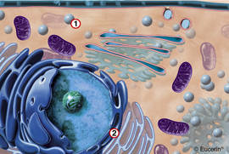
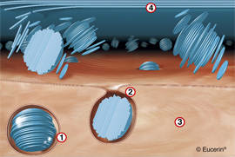
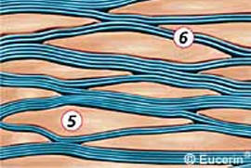
Lamellar granules (Odland bodies)
Initial production in upper spinous layer (Golgi production):
  Round membrane-bound, lipid-rich organelles with lamellar (light and dark) internal structure.
  Major component = Ceramides
    Lamellar granules also contain cholesterol, free fatty acids, etc.
  Granules migrate to periphery of cell & expel contents into extracellular space
  Forms the “mortar” for the “brick-like” keratinocytes
“brick”
“brick”

Slide 40
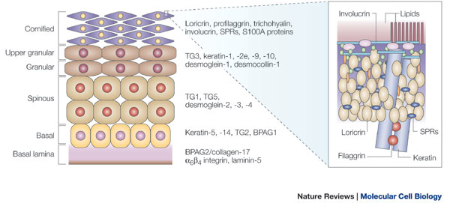
Clinical Correlations with
Lamellar granules (Odland bodies)
Harlequin ichthyosis:
  Abnormal/absent granules
  Mutation in lipid transporter gene (ABCA12)
X-linked ichthyosis:
  Steroid sulfatase mutation results in component missing from granules
Sjogren-Larsson syndrome:
  Fatty aldehyde dehydrogenase mutation
Flegel disease (or hyperkeratosis lenticularis perstans):
  Shows decreased granules
Image from “The cornified envelope: a model of cell death in the skin” by Eleonora Candi, Rainer Schmidt & Gerry Melino, Nature Reviews Molecular Cell Biology 6, 328-340 (April 2005)

Slide 41
Keratohyaline granules
Ribosomal production in granular layer
Two important types of keratohyaline granules:
  L- granules contain Loricrin :
    The major protein of the cornified envelope
  F-Granules contain Profilaggrin (inactive, phosphorylated, large polymer)
    Precursor to Filaggrin (dephosphorylated, histidine rich)
    “Wraps” the keratin in the cytoplasm to help align filaments
Image from “The cornified envelope: a model of cell death in the skin” by Eleonora Candi, Rainer Schmidt & Gerry Melino, Nature Reviews Molecular Cell Biology 6, 328-340 (April 2005)

Slide 42
Clinical Correlations with
Keratohyaline Granules
Icthyosis vulgaris & atopic dermatitis
  Filaggrin mutations
Vohwinkel syndrome w/o deafness
  Loricrin defect
Granular parakeratosis
  Cells lack filaggrin
Natural moisturizing factor (degraded filaggrin)
  Component of normal skin
Image from “The cornified envelope: a model of cell death in the skin” by Eleonora Candi, Rainer Schmidt & Gerry Melino, Nature Reviews Molecular Cell Biology 6, 328-340 (April 2005)

Slide 43
REGULATION OF
KERATINOCYTE STEM CELL & TA CELL
1.) Multiple factors regulate keratinocyte transition in the epidermis, such as:
  Vitamin D (i.e.,topical calcipotriene):
    In a proliferative condition, it “schools” the keratinocytes to differentiate and suppress their proliferation……thus, may improve psoriasis and other disorders
2.) Multiple factors determine how the stem cells replicate and keratinocytes differentiate, such as:
  β-catenin (free, non-cadherin related type):
    Increases stem cell population & hair follicle development
    Elevated in Pilomatricomas & Trichofolliculomas
  Hedgehog pathway
TA cells
Stem cells
TA cells

Slide 44
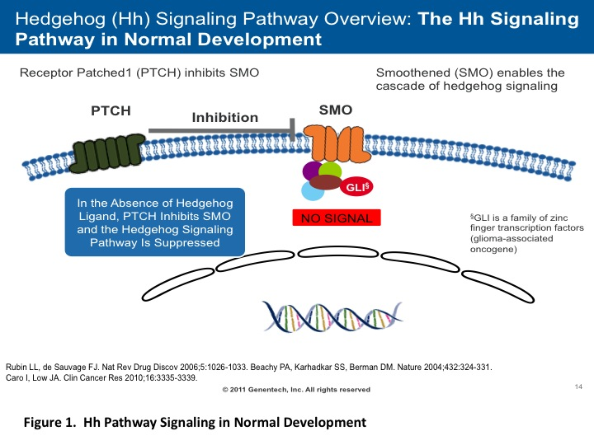
Hedgehog Pathway
(Normal operation – Inactive)
PTCH
“smothers”
SMO and is the “Brake”, so no signal!
Inactive Pathway:
  PTCH inhibits activity of SMO (smoothened) & stops pathway activation

Slide 45
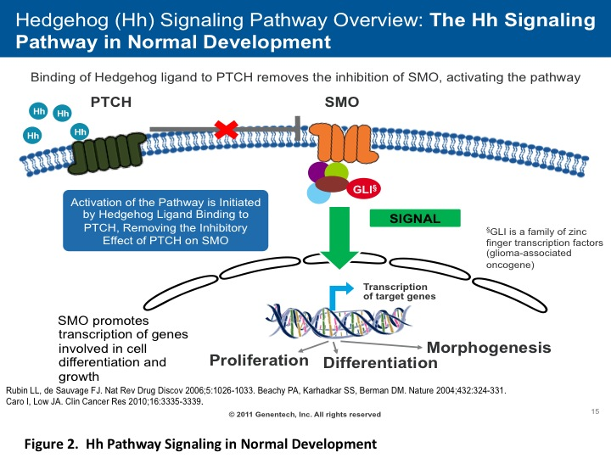
Hedgehog Pathway
(Normal operation – Active)
Hh
Hedgehop “picks on” PTCH, which allows SMO to get busy (“gas peddle”)!
Active Pathway:
  Hedgehog ligand (Hh) inhibits PTCH, which causes de-repression of SMO

Slide 46
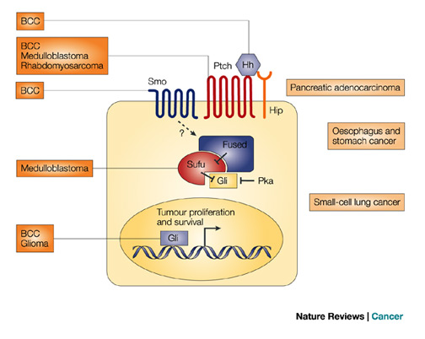
Hedgehog Pathway Misregulation & Cancer Risk
Depending on the tissue type, defects in the hedgehog pathway causes an increased risk of various cancers (not just BCC).

Slide 47
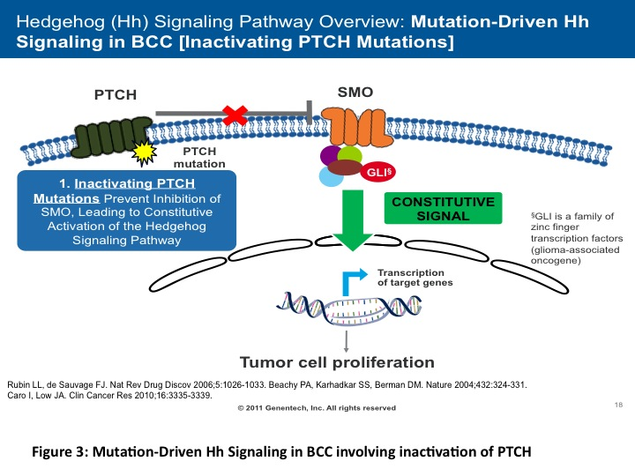
Hedgehog Pathway & BCC
PTCH Mutation: SMO is not inhibited, so leads to risk of basal cell carcinoma, medulloblastoma, rhabdomyosarcoma, etc.
  Thus, PTCH can be considered a tumor suppressor gene (“brake”) & SMO as oncogenic (“gas peddle”)

Slide 48
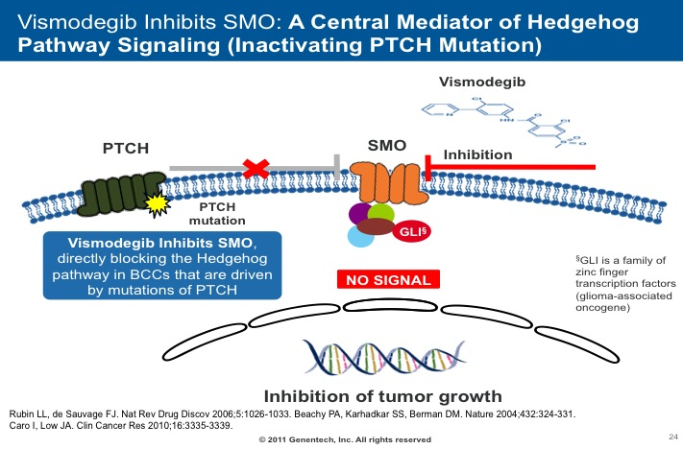
Basal Cell Carcinoma Therapy
Vismodegib: Inhibits PTCH and SMO mutation activations by inhibition of SMO
  Uses: Advanced or metastatic BCC and possibly Gorlin syndrome
  Side effect: Increased risk of SCC/KA’s

Slide 49
Epidermal
Cell Connections

Slide 50
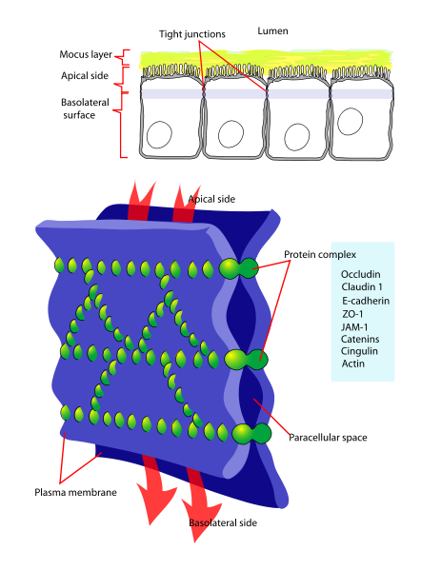
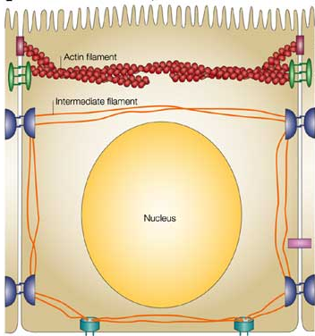
Types of Cell Connections
Tight junctions = Form at the apical end of lateral membranes forming paracellular diffusion barriers
Image from Wikimedia Commons, created by LadyofHats
Image from www.nature.com

Slide 51
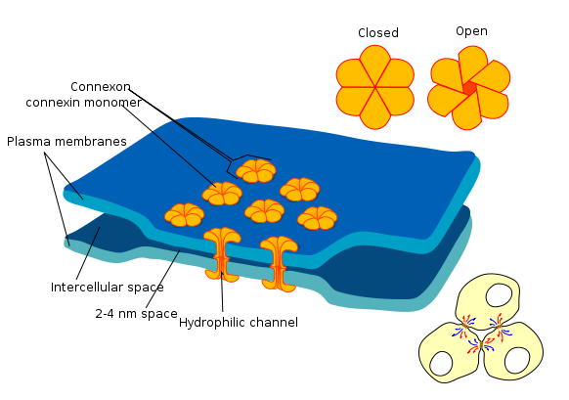
Types of Cell Connections
Tight junctions = Form at the apical end of lateral membranes forming paracellular diffusion barriers
Gap junctions = Intercellular channels between adjacent cells that allow the direct passage of low molecular weight metabolites between cells
  Connexins
Image from Wikimedia Commons, created by LadyofHats
Image from www.nature.com

Slide 52
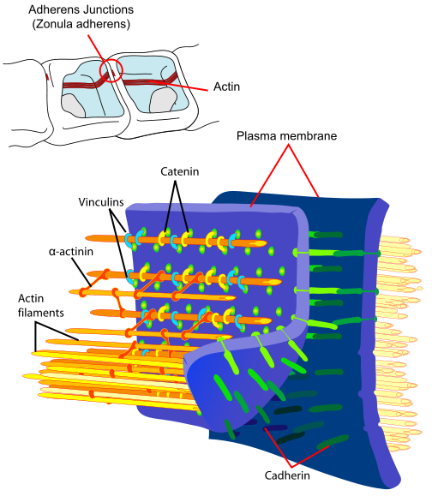
Types of Cell Connections
Tight junctions = Form at the apical end of lateral membranes forming paracellular diffusion barriers
Gap junctions = Intercellular channels between adjacent cells that allow the direct passage of low molecular weight metabolites between cells
  Connexins
Adherens junctions = Adhesion site that links the actin cytoskeletal components of two cells
  Important in cell signaling also
Image from www.nature.com
Image from Wikimedia Commons, created by LadyofHats

Slide 53
Types of Cell Connections
Tight junctions = Form at the apical end of lateral membranes forming paracellular diffusion barriers
Gap junctions = Intercellular channels between adjacent cells that allow the direct passage of low molecular weight metabolites between cells
  Connexins
Adherens junctions = Adhesion site that links the actin cytoskeletal components of two cells
  Important in cell signaling also
Desmosomes = Adhesion site that links the keratin cytoskeletal components of two cells
  Desmocollin, desmoglein, etc.
Hemidesmosomes = Adhesion site that links the keratin cytoskeletal components of a cell to extracellular matrix (basement membrane)
  BPAG1, BPAG2, Plectin, etc.
Image from www.nature.com

Slide 54
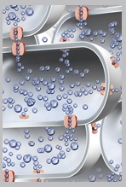
Another Connection – Aquaporin 3 (AQP3)
Transmembrane protein channel in the epidermis:
  Multiple variants are found in various tissues (i.e., kidneys, eyes, brain, etc.)
Main Function = Water & Glycerol transport
  Also role in hydration, wound repair, cell migration, etc.
Increased with various skin stressors/disorders:
  Atopic dermatitis, medications (retinoic acid), skin carcinoma (such as SCC)
Often discussed today in marketing
Image from http://en.wikinoticia.com/lifestyle/psychology/48348-eucerin-aquaporins--revolutionizes-skin-hydration

Slide 55
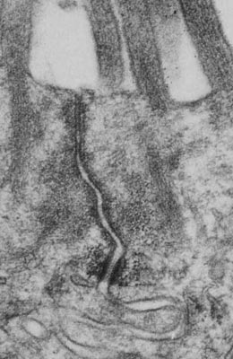
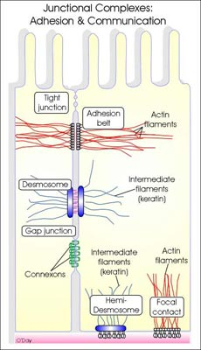
Cell Connection Images
Tight junction
Adherens junction
Desmosome
(“High Yield”)
Images from www.utm.utoronto.ca
(Lecture by O’Day DH, “Human Cell Biology”)

Slide 56
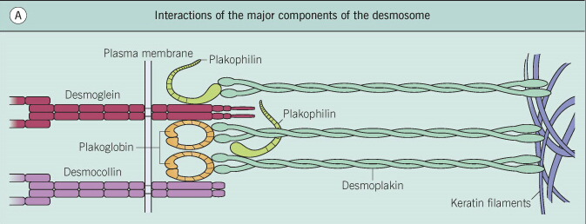
Desmosome Overview
Transmembrane proteins:
  Desmoglein 1 (160 kDa) & 3 (130 kDa)
  Desmocollins
Intracellular proteins:
  Plakoglobin
  Plakophilin
  Desmoplakins
Structure support = Keratin filaments (i.e., tonofilaments)
Extracellular-side
Intracellular-side
© 2003 Elsevier – Bolognia, Jorizzo and Rapini: Dermatology – www.dermtext.com

Slide 57
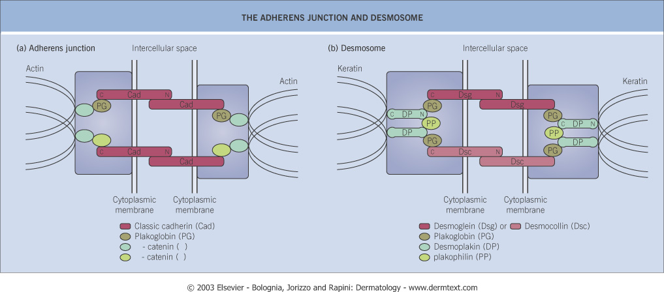
Adherens junction vs. Desmosome
 | Adherens Junction | Desmosome
Structure support
Cytoplasmic proteins
Transmembrane proteins
Epidermal Cells involved
Actin
Keratin
Plakoglobin, Catenins
Plakoglobin, Plakophilin
Cadherins (i.e., E-cadherin)
Desmoglein, Desmocollin
Keratinocytes, Melanocytes, Langerhans cells
Keratinocytes

Slide 58
Desmosome Clinical Correlation
(antibodies & mutations)
Desmoglein 1:
Pemphigus foliaceus, Toxin in SSSS
NON-bullous desmosome mutations:
• Plakoglobin = Naxos disease
• Desmoplakin = Carvajal syndrome
PPK + Woolly hair + cardiomyopathy
Desmoglein 1 & 3:
PV (mucocutaneous)
Desmoglein 3:
Mucosal-dominant PV
Paraneoplastic Pemphigus
© 2003 Elsevier – Bolognia, Jorizzo and Rapini: Dermatology – www.dermtext.com
Desmocollin:
IgA Pemphigus (SPD type)
Plakophilin: Ectodermal dysplasia – skin fragility syndrome
Desmoplakin: Lethal acantholytic
epidermolysis bullosa

Slide 59
Basement
Membrane Zone
(BMZ)

Slide 60
Basement Membrane
Functions:
  Substrate for attachment of cells
  Templates for tissue repair
  Matrices for cell migration
  Substrata to influence differentiation, morphogenesis & apoptosis of epithelial cell layers
  Permeability barriers for cells & macromolecules

Slide 61
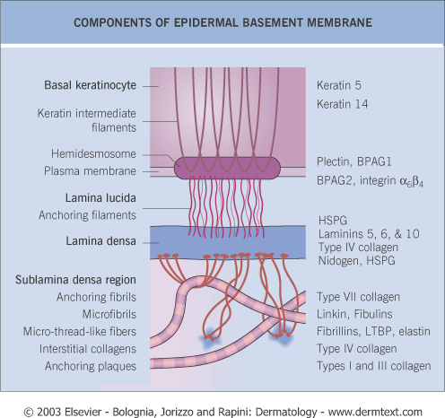
Basement Membrane Components
Origin of constituents:
  Keratinocytes produce the majority of proteins (ectodermal origin):
    Plakins (“The Planks”)
      Plectin (500 kDa)
      BPAG1 (230 kDa)
      Other Plakins in other cellular connections (desmoplakin, etc.)
    Other proteins:
      BPAG2 (180 kDa)
      Integrin subunits
      Heparan sulfate proteoglycans (esp. Perlecan)
  Dermal fibroblasts produce:
    Nidogen (“links-things”)
    Type IV collagen
    Type VII collagen

Slide 62
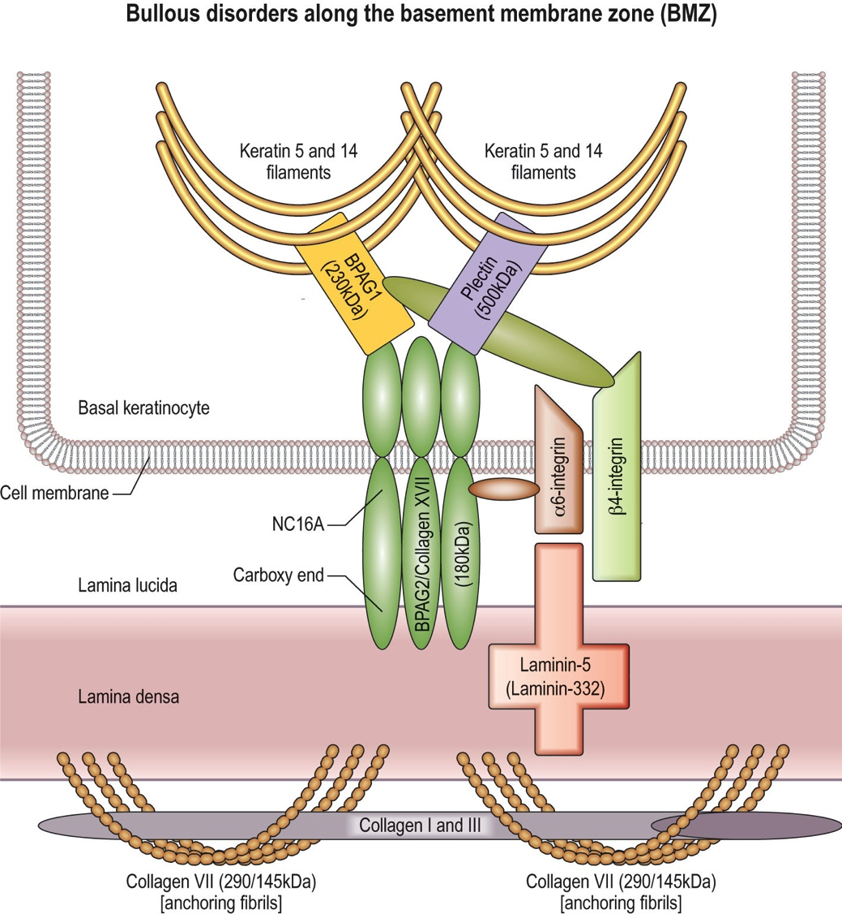
BMZ
Collagen IV
Sublamina densa

Slide 63
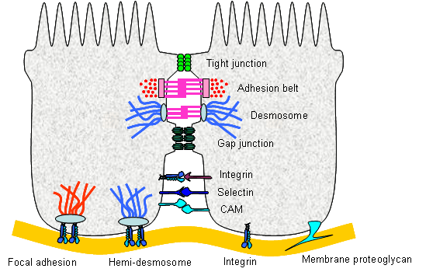
Focal adherens contact
Type of focal contact junction:
  Similar to adherens junction
  Differs from hemidesmosome by:
    Actin vs. keratin
    α3β1 integrin vs. α6β4
    Associated with Kindlin protein (Kindler syndrome)
Image from http://cellbiology.med.unsw.edu.au

Slide 64
The Hemidesmosome
Tonofilaments
  Keratin-5
  Keratin-14
Blistering genetic disorder:
Epidermolysis bullosa simplex (EBS)
Non-blistering conditions:
Keratin 5:
  Dowling –Degos disease (DDD) or Pigmented reticulate anomaly of the flexures
  Galli-Galli disease (DDD histo-variant)
Keratin 14:
  Naegeli-Franceschetti-Jadassohn (NFJ) syndrome
  Dermatopathia pigmentosa reticularis (DPR)
  In NFJ & DPR, patients lack dermatoglyphics (i.e., fingerprints)

Slide 65
The Hemidesmosome (cont.)
Mutation = EBS with MD
Antibodies = Paraneoplastic pemphigus
Antibodies = BP & Paraneoplastic pemphigus
Plakin family:
Cytoplasmic plaques:
  The “Planks” in basal keratinocytes & BMZ
  BPAG1 = 230 kDa
  Plectin = 500 kDa
Adhesion points with cytoskeleton
More Plakins present in other cell junctions:
  Desmoplakin
  Periplakin
  Envoplakin

Slide 66
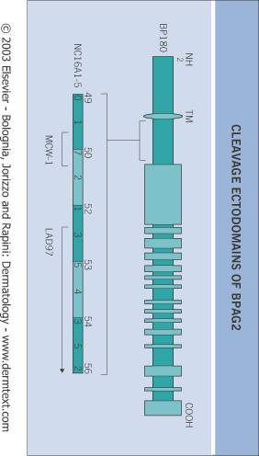
TM = Transmembrane
The Hemidesmosome
Mutation = Junctional EB
Antibodies = BP (NC16A), CP,
Gestational Pemphigoid,
Linear IgA/Chronic bullous disease of childhood (97 kDa)
BPAG2:
Type XVII collagen:
  Transmembrane
180 kDa full length
120 kDa extracellular:
  15 Gly-X-Y repeats
  1st of 16 non-collagenous segment = NC16A, binds to Integrin α6 subunit
Attaches to:
  Plectin
  BPAG1
  Integrin

Slide 67
The Hemidesmosome (cont.)
Mutation = JEB with pyloric atresia
Antibodies = Ocular CP (β4 subunit)
Integrins:
Transmembrane proteins
αβ-heterodimers
Main skin integrin = α6β4
Associates with:
  Laminin 5
  NC16A of BPAG2
  Cytoplasmic BPAG2
  Plectin
  BPAG1

Slide 68
Anchoring Filaments/Plaques/Fibrils/ in the BMZ
Anchoring Filaments: Typically, cross the lamina lucida, such as:
  Laminins (5, 6, 7, 10)
  BPAG2
  Uncein (19-DEJ-1 antigen)
Anchoring Plaques:
  Type IV collagen (mainly)
Anchoring Fibrils:
  Type VII collagen
  Microfibrils (oxytalan fibers)
Collagen IV

Slide 69
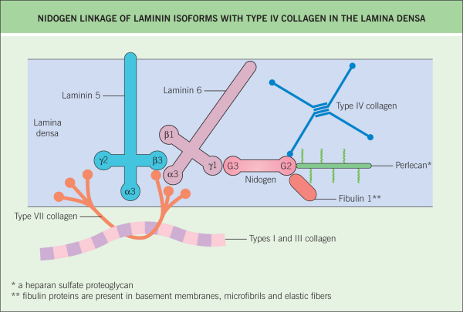
Lamina densa
Integrin
“Links” proteins in lamina densa
Major heparan sulfate proteoglycan in the basement membrane

Slide 70
Anchoring Filaments
Laminins:
  Laminin-5 (Laminin-332) is the major one:
    Bridges α6β4 integrin to Col VII
  Laminin-6
    Connects to Collagen IV by nidogen
  Laminin-7 (fetal skin only)
Mutation = JEB (Herlitz & non-Herlitz)
Antibodies = Anti-epiligrin CP (increased risk of cancer, esp. solid tumors)

Slide 71
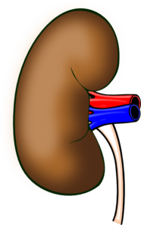
Anchoring Plaques
Collagen IV (main one):
Specifically localized only within basement membranes (skin, kidneys, etc.)
Different variants (vary by subunits)
Nidogen connects it with Laminin-6
Alport syndrome (COL4A5 gene mutations usually):
Mult. variations of hereditary nephritis + deafness
Skin-issues = Leiomyomatosis (mult. leiomyomas)
Goodpasture syndrome (autoimmune):
Glomerulonephritis + Pulmonary hemorrhage +
Anti-glomerular basement membrane antibodies
Skin-wise = May have pruritic rash
Note: NO typical skin lesions since associated with different α-subunits of Collagen IV than skin’s type
Collagen IV

Slide 72
Anchoring Fibrils
Collagen VII (290 kDa):
  Only in basement membrane of stratified squamous epithelium
  “Fan-shaped” due to interruption of Gly-X-Y
  Assoc. with Laminin-5, collagen I/III
  Wraps around collagen I & III
    Like a “7-shaped sling”
Mutation = Dystrophic forms of EB
Autoimmune:
  Bullous SLE
  EBA (assoc. with IBD, thyroiditis, etc.)
  Subset of Linear IgA bullous disease

Slide 73
Laboratory Diagnosis of BMZ Disorders

Slide 74
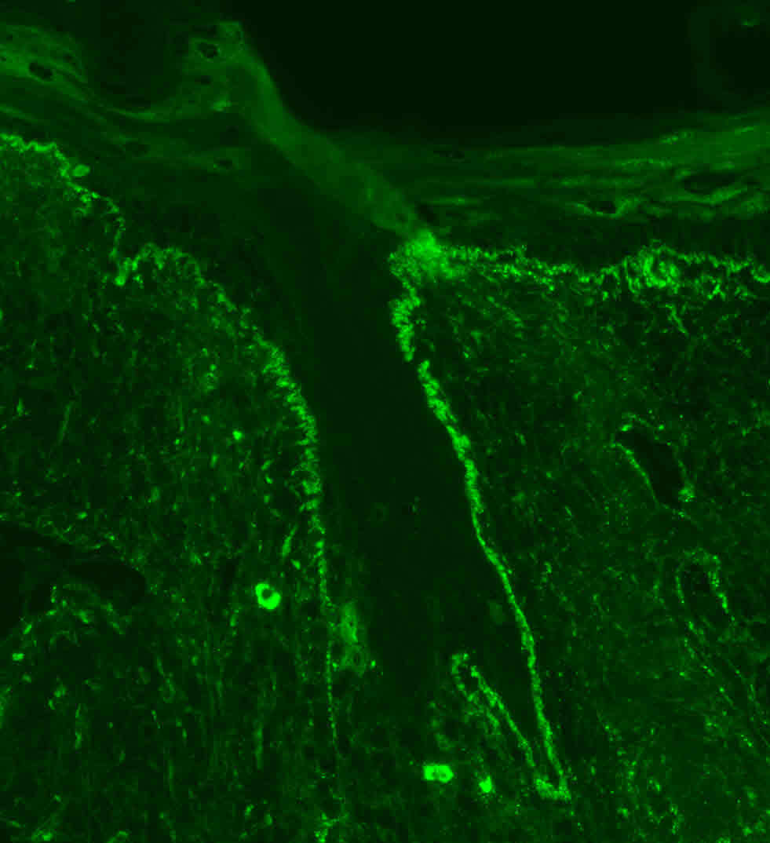
Direct vs. Indirect IF
Direct immunofluorescence
  Patient tissue + Test sera
  Use single primary Ab with fluorophore & a specific target (e.g., IgG, C3)
Indirect immunofluorescence
  Test tissue + Patient sera
  Use 2 antibodies (primary Ab is patient’s Ab & second Ab with a fluorophore binds primary Ab)
NOTE: Michel’s transport medium solution = Ammonium sulfate (precipitates antigen-antibody complexes), N-ethyl-maleimide, potassium citrate buffer, magnesium sulfate & distilled water

Slide 75
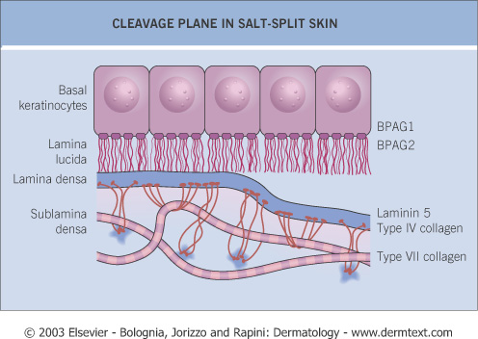
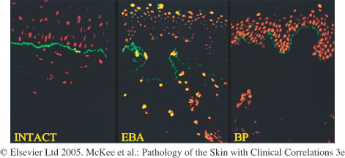
BMZ & the
Salt-Split Skin Procedure
Skin or Substrate tissue in 1M of NaCl mix
  Splits skin along lamina lucida
May use antibodies to help differentiate disorders (immunomapping):
  Such as BP on the “roof” vs. EBA on the “floor”

Slide 76
Salt-split skin is more than BP vs. EBA
Classically, epidermal-side:
  BP
  Pemphigoid gestationis
  Linear IgA (usually)
  CP
Classically, dermal-side:
  EBA
  Anti-epiligrin CP
  Linear IgA (rarely)
  P200 pemphigoid
  P105 pemphigoid

Slide 77
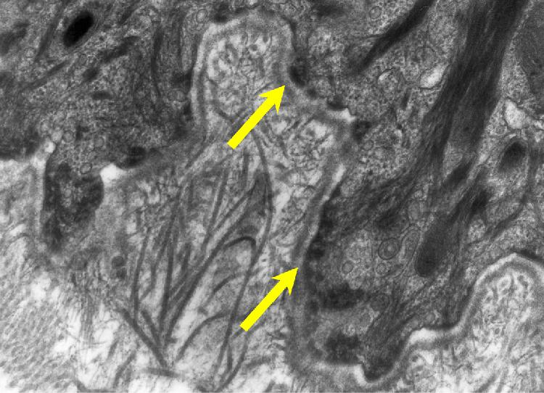
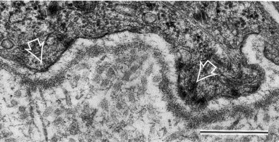
EB Diagnosis
#1. Electron microscopy (old “Gold” standard method)
Remember, immunofluorescence NOT work for any EB disorder,
since not autoimmune
Normal skin
JEB skin
Image from McGrath JA et al, “Moderation of
Phenotypic Severity…”J of Invest. Derm (1999) 113, 314–321
Image from www.xgene.com/html/technologies/Skineng.htm

Slide 78
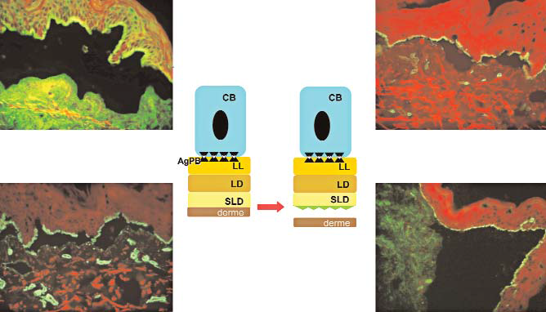
EB Diagnosis (cont.)
#2. Immunomapping of basement membrane antigens (new method)
Put antigens to newly formed blister
  < 24 hours old to avoid misdiagnosis with re-epithelialization
  Antigens often include BP-180, B4 integrin, Laminin-5, Type IV collagen, Type VII collagen
    Maps out the blister cavity (roof vs. floor) to determine EB variant
Dominant DEB
All antibodies mark the “roof,” thus split is in sublamina densa in this case.
Anti-BPAG Ab
Anti-Laminin Ab
Anti-Collagen VII Ab
Anti-Collagen IV Ab
Image from Oliveira ZNP, et al., “Immunological mapping in hereditary epidermolysis bullosa” An Bras Dermatol 2010; 85(6): 856-61.

Slide 79
Epidermolysis Bullosa (EB)
BMZ Clinical Correlation
with

Slide 80

EB Overall
Hereditary disorders with mechanically-induced blisters, possible scarring / milia
#1 cause of death after adolescence = SCC
  Especially with Hallopeau-Siemens RDEB variant
TX = Typically use non-adhesive dressings only, avoid trauma
Image from emedicine.medcscape.com

Slide 81
Epidermolysis Bullosa Simplex (EBS) Variants
All autosomal dominant & have keratin 5, 14 mutations except:
  EBS with MD – autosomal recessive (Plectin mutation)
Clinically:
  No inflammation
  Intraepidermal cleavage
    Basement membrane intact
    Defect in cytoplasmic-side of basal cells
  NO scarring (usually) or milia since above basement membrane

Slide 82


Generalized EBS - Koebner
Onset = Birth or infancy (autosomal dominant)
Presentation:
Generalized blisters on hands/feet & extremities
Spares nails, teeth & oral mucosa
Worse in warm weather
Images from emedicine.medscape.com

Slide 83

Localized EBS – Weber-Cockayne
Onset = Childhood / Early adult life
  Most common type (autosomal dominant)
Presentation:
Thick-walled blisters on hands/feet after exercise
  Remember = Two hands & two words in the name….Weber-Cockayne
Hyperhidrosis
Secondary infection of blisters
Worse in warm weather

Slide 84


EBS Herptiformis – Dowling Meara
Onset = Birth (autosomal dominant)
Presentation:
Grouped blisters (“EBS Herpetiformis”) on trunk, proximal extremities
  May involve oral mucosa
Nails may shed
NOT affected by weather
EM finding:
  Clumping of tonofilaments in basal keratinocytes (not a specific finding)

Slide 85

EBS with Muscular Dystrophy
Autosomal recessive, similar Koebner clinically
Only EBS that is NOT due to keratin mutation:
  Plectin (Think “Plectin…..P….pectoralis muscle”)
Adult onset muscular dystrophy
Assoc. with congenital myasthenia gravis (Ab to acetylcholine receptors)

Slide 86
Junctional EB (JEB) Overall
All JEB are Autosomal recessive
All variants of JEB have abnormal Uncein (19 -DEJ-1) protein
    An anchoring filament-associated protein
Involve Laminin-5 (Laminin-332) in some way:
  Mutation
  Mutation in connection to Laminin-5 (i.e., BPAG2)
Blister form in lamina lucida due to defect
Enamel hypoplasia is characteristic of all forms of JEB

Slide 87


JEB-pyloric atresia
Similar to JEB-Herlitz but pyloric atresia at birth
Mutation = Integrin α6β4
May have urologic abnormalities (hydronephrosis, nephritis)

Slide 88

JEB-non Herlitz
Old name “Generalized atrophic benign EB”
Moderate or severe JEB at birth
Mutation involving Laminin-5 & BPAG2
Typically survive & improve with age
Clinical:
  Scalp & nail involvement
  Enamel defects (pitting)
  Mild mucosal involvement
  Periorificial non-healing erosions

Slide 89

JEB-Herlitz
Most severe form, high mortality (40% by 1st year)
Lack Laminin-5 (termination codon)
Blisters at birth, periorificial granulation tissue, dystrophic teeth, lost nails, scalp involved, hoarseness (bad sign)
Also involve extracutaneous areas (GI, GU, respiratory)

Slide 90
Dystrophic EB Overall
Both dominant & recessive forms
Due to defect in collagen VII (anchoring fibrils), chromosome 3
Blister form in sublamina densa split due to defect
  Reduced or lacking collagen VII fibers
Healing after blisters assoc. with scarring & milia
  Risk of SCC formation in scars
In recessive forms:
  May form pseudosyndactyly (“mitten deformities”)
    Esp. Hallopeau-Siemens subtype

Slide 91


Dominant Dystrophic EB
Point mutation with glycine-to-arginine substitution interferes with triple helix formation of Type VII collagen (reduced fibers)
Prone to SCC formation in scars

Slide 92


Recessive Dystrophic EB
Hallopeau-Siemens:
Stop codon mutation (lack collagen VII)
Mutilating disease, “mitten deformities”
Nail, teeth, scalp & most mucosal surfaces involved
Possible esophageal strictures
High SCC risk (50% by age 35)
Non-Hallopeau-Siemens:
Defect in collagen VII
Similar clinically to localized form of DDEB
Less severe blistering at birth, acral involvement with atrophic scarring, nail dystrophy; BUT little mucosal involvement
Image from www.ebinfoworld.com/abouteb_dystrophic.htm

Slide 93

Kindler Syndrome
First genodermatosis (AR) caused by a defect in actin-ECM linkage rather than keratin-ECM linkage like EB
  Neonatal blistering, acral skin blistering with minor trauma, photosensitivity, progressive poikiloderma, and diffuse cutaneous atrophy
    “Dystrophic EB + Poikiloderma”
Mutation = KIND1 (Kindlin-1 protein)
    Plays role with linking the actin cytoskeleton to the extracellular matrix (i.e., focal adhesion contacts)
    Possibly play a regulatory role in inhibiting over-secretion of basement membrane components by basal keratinocytes at the DE junction
Image from “Kindler Syndrome” at
www.emedicine.medscape.com

Slide 94
Some “newer” EB Variants
Lethal acantholytic epidermolysis bullosa
  Desmoplakin mutation
  Cutaneous & mucosal shedding with early death, total alopecia, anonychia
Ectodermal dysplasia-skin fragility syndrome
  Plakophilin-1 mutation
  Chronic cheilitis, perioral scaling, nail & hair abnormalities
Integrin α-3 mutation
  Autosomal recessive form of EB
  Mild skin fragility, fatal interstitial lung disease, nephrotic syndrome
Acral peeling skin syndrome
  Transglutaminase-5 mutations
  Acral blisters when infant; but as age, more peeling with occasional blisters
  Cleavage in upper epidermis at stratum granulosum & stratum corneum level

Slide 95
Mini-Review

Slide 96
What cell migrates and is typically seen first in the epidermis?
Melanocytes
Keratinocytes
Langerhans cells
Merkel cells
All about the same time

Slide 97
What structure typically begins developing last?
Eccrine gland
Apocrine gland
Sebaceous gland
Hair follicle
Nails

Slide 98



What enzyme in collagen synthesis requires copper?
Tyrosinase
Prolyl hydroxylase
Lysyl hydroxylase
Lysyl oxidase
Collagen fibrils cross-linked

Slide 99
What is the main component of the cornified cell envelope?
Loricrin
Involucrin
Profilaggrin
Filaggrin
Ceramide

Slide 100
What protein is present in both desmosomes & adherens junctions?
Plakoglobin
Desmocollin 1
E-cadherin
Desmoglein 3
Desmoglein 1

Slide 101
What adherens junction protein is not present in a desmosome?
Plakoglobin
Desmocollin 1
E-cadherin
Desmoglein 3
Desmoglein 1

Slide 102

What is the molecular weight (kDa) of BPAG2?
160
180
210
230
500

Slide 103
Autoantibodies to Type XVII collagen are characteristic of:
Bullous pemphigoid
Linear IgA bullous disease
Cicatricial pemphigoid
Pemphigoid gestationalis
A & C
All of the above

Slide 104

An antibody to this protein is the most likely cause of these back lesions:
Desmocollin 1
Desmoglein 1
Desmoglein 3
BPAG1
BPAG2

Slide 105

An antibody to this protein is the most likely cause of this condition:
130 kDa
160 kDa
180 kDa
Laminin-332
500 kDa

Slide 106
An infant presents with "grouped blisters."
Biopsies show a separation that begins in the basal cell layer and a negative DIF.
The father has a history of recurrent blisters also.
What is the most likely diagnosis?
EBS, Koebner variant
Bullous pemphigoid
Epidermolysis bullosa acquisita
Junctional EB – non-Herlitz
EBS, Dowling-Meara variant

Slide 107
Match the disorder with its most likely associated collagen:
Bullous Pemphigoid
Osteogenesis imperfecta
Dominant DEB
Relapsing polychondritis
Epidermolysis bullosa acquisita
Collagen I mutation
Collagen II antibodies
Collagen type VII mutation
Collagen type VII antibodies
Collagen XVII antibodies

Slide 108
Self-Review

Slide 109
Self-Review Answers
Image from Johnston, R. Weedon’s Skin Pathology Essentials. 2012

Slide 110
Acknowledgement
Portion of keratinocyte basic science section from a lecture by Dan Spandau, Department of Dermatology and Biochemistry & Molecular Biology, Indiana University at the Basic Science Review (2007)

